Slide 1
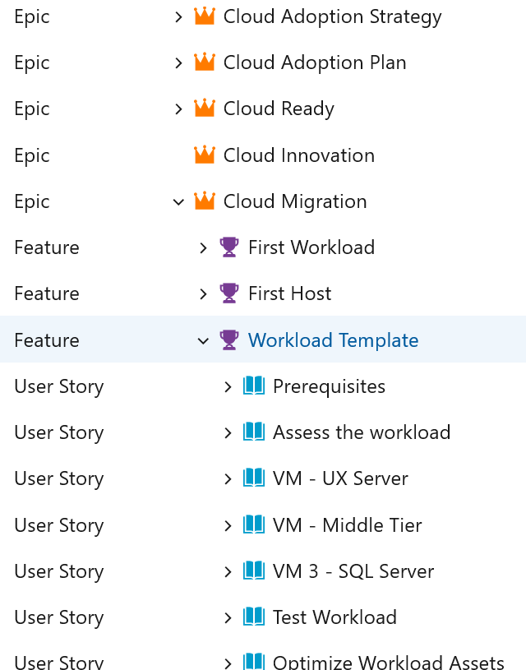
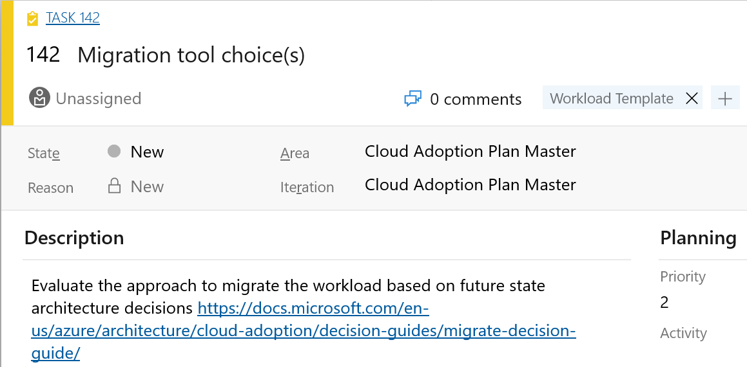
Azure DevOps Cloud Adoption Plan Generator
Leverage Azure DevOps to log and track your cloud adoption plan:
aka.ms/adopt/plan

Slide 2
Cloud Adoption Framework for Azure Overview
Notes:
Welcome slide

Slide 3
Azure Virtual Workshop:
Prepare your landing zone using Cloud Adoption Framework
Morning : Overview/Ready/Govern/Manage – 3 hrs
Level | Duration | Content
L100 | 30min | Cloud Adoption Framework Overview Provide an overview of the Cloud Adoption Framework and help customers think about their cloud strategy and create an actionable cloud adoption plan.
L200 | 60 min | Unlock cloud adoption using Azure landing zones Provide an overview of the Azure landing zones, why are they important and what are the different landing zones implementation options. Customers will also go through an operating model exercise to decide what option would best suit their needs.
L200 | 45 min | Establish cloud governance using the Cloud Adoption Framework Leverage the agile, iterative methodology to enable governance maturity without impeding migration or innovation.
L200 | 45 min. | Manage your cloud operations to achieve business value Learn the best practices to support ongoing cloud operations to deliver tangible business outcomes.
Afternoon : Hands-On Exercises – 3hrs.
L300 | 15 Min. | Introducing Hands-on-lab(HOL) process & goals for the afternoon
 | 30 min | HOL 1: Start small and expand landing zone implementation option
 | 45 min | HOL 2: Governance Create a governance MVP by setting up management groups, resource groups, cost management and RBAC
 | 60 min | HOL 3: Enterprise scale landing zones lab
 | 30 Min. | Next steps & how to get started

Slide 4
Agenda
Overview of the Microsoft Cloud Adoption Framework for Azure
Define your strategy
Put together your cloud adoption plan

Slide 5
Overview of the Microsoft Cloud Adoption Framework for Azure
Notes:
Ref: https://docs.microsoft.com/en-us/azure/cloud-adoption-framework/overview

Slide 6
Microsoft Cloud Adoption Framework for Azure
Best practices
Templates
People
Process
Technology
Achieve balance
Documentation
Tools
Control & Stability
Speed & Results
Align business, people and technology strategy.
Achieve business goals with actionable, efficient, and comprehensive guidance.
Deliver fast results with control and stability.
Notes:
<Key point>: Change is more than adopting technology. It’s adapting how you do business.
The Microsoft Cloud Adoption Framework for Azure means changing how you do business—not just swapping out technology, but changing your enterprise, the culture behind it, and you too.
We share best practices from our employees, partners, and customers who have already undertaken the cloud journey.
The Cloud Adoption Framework brings together people, process, and technology—a strategy that’s aligned to your business goals.
Quickly—efficiently, and with actionable guidance, it provides guidance for your organization’s agile business transformation.
Leading people through change is difficult. It’s not just the technology that changes. It’s your people and processes too.
We can help guide you through.
<Transition>: How does the Cloud Adoption Framework work for your business?

Slide 7
Microsoft Cloud Adoption Framework for Azure Proven business and technical guidance to help customers create and implement the business and technology strategies necessary to succeed in the cloud.
Define strategy
Define business justification and expected outcomes
Plan
Align actionable cloud adoption plan to business outcomes
Ready
Prepare people, process and environment for change
Adopt
Migrate or Innovate
Implement desired changes across IT and business processes
Govern
Comply, control and secure
Manage
Operate and optimize
Notes:
<Key point>: Cloud Adoption Framework—modular phases of adoption.
As your organization evolves, the Cloud Adoption Framework adapts to your business needs.
Each module in the diagram is an iterative phase that advances your business through the complete lifecycle of cloud adoption.
Customers can choose the phase best-suited to their degree of cloud adoption maturity. The Cloud Adoption Framework offers a guiding methodology to cloud adoption, with specific approaches to overcoming common blockers to cloud adoption in each module, such as “Define Strategy,” “Plan,”, etc.
The Cloud Adoption Framework offers the enterprise a modular framework of how to incrementally onboard to the cloud.
Cloud adoption shifts how companies obtain, make use of, and lock down their technology resources.
And—this kind of modular framework flips the model of how enterprises operate:
Transitions organizations to need-based consumption of technology resources
Change from cap-ex (capital expenditure) to op-ex (operating expenditure) model
Cloud model assumes security, governance, cost-optimization, and hybrid cloud by default
Develop a future-ready workforce—developing and deploying cloud skill readiness organization-wide
As an organization progresses through the Cloud Adoption Framework, what are the main goals of each methodology of “Define Strategy,” “Plan,” you can focus efforts on?
<Transition>: Let’s look at some possible motivations for cloud adoption, and what some common blockers are that the Cloud Adoption Framework can help you resolve.

Slide 8
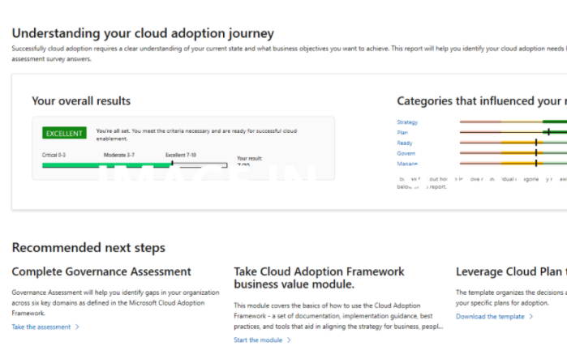
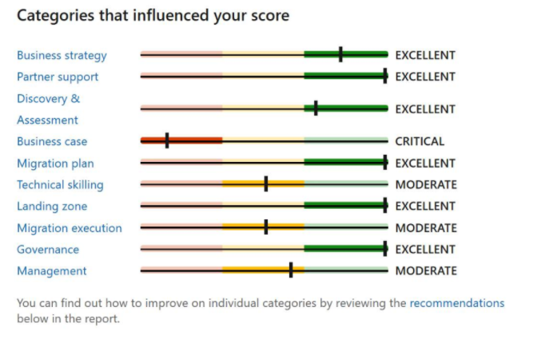
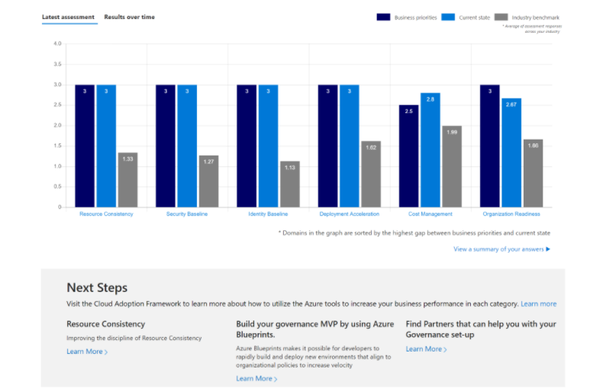
Evaluate your cloud readiness using Microsoft Assessments
Strategic Migration Assessment & Readiness Tool
Cloud Journey Tracker
Governance Benchmark
Identify your cloud adoption needs and find recommendations for your unique cloud journey.
Understand your organization’s preparedness to implement a cloud migration at scale.
Identify gaps in your organization’s current state of governance and get curated guidance on how to get started.

Slide 9
Other tools, templates, and assessments
Define strategy
Cloud journey tracker
Business outcome template
Plan
Azure DevOps demo generator
Cloud adoption plan template
Ready
Azure setup guide
Readiness checklist
Naming and tagging tracking template
Landing zone blueprints
Adopt
Strategic migration assessment and readiness tool (SMART)
Azure migration guide
Azure innovation guide
Govern
Governance benchmark
Governance process template
Cost Management process template
Deployment acceleration process template
Identity process template
Resource consistency process template
Security baseline process template
Manage
Microsoft Azure Well-Architected Review
Best practices source code
Operations management workbook
Notes:
<Key point> We have tools, assessments, and other assets to support your cloud adoption journey.

Slide 10
Microsoft Cloud Adoption Framework for Azure Proven business and technical guidance to help customers create and implement the business and technology strategies necessary to succeed in the cloud.
Define strategy
Define business justification and expected outcomes
Plan
Align actionable cloud adoption plan to business outcomes
Ready
Prepare people, process and environment for change
Adopt
Migrate or Innovate
Implement desired changes across IT and business processes
Govern
Comply, control and secure
Manage
Operate and optimize
https://aka.ms/adopt/overview
Notes:
<Key point>: Cloud Adoption Framework—modular phases of adoption.
As your organization evolves, the Cloud Adoption Framework adapts to your business needs.
Each module in the diagram is an iterative phase that advances your business through the complete lifecycle of cloud adoption.
Customers can choose the phase best-suited to their degree of cloud adoption maturity. The Cloud Adoption Framework offers a guiding methodology to cloud adoption, with specific approaches to overcoming common blockers to cloud adoption in each module, such as “Define Strategy,” “Plan,”, etc.
The Cloud Adoption Framework offers the enterprise a modular framework of how to incrementally onboard to the cloud.
Cloud adoption shifts how companies obtain, make use of, and lock down their technology resources.
And—this kind of modular framework flips the model of how enterprises operate:
Transitions organizations to need-based consumption of technology resources
Change from cap-ex (capital expenditure) to op-ex (operating expenditure) model
Cloud model assumes security, governance, cost-optimization, and hybrid cloud by default
Develop a future-ready workforce—developing and deploying cloud skill readiness organization-wide
As an organization progresses through the Cloud Adoption Framework, what are the main goals of each methodology of “Define Strategy,” “Plan,” you can focus efforts on?

Slide 11
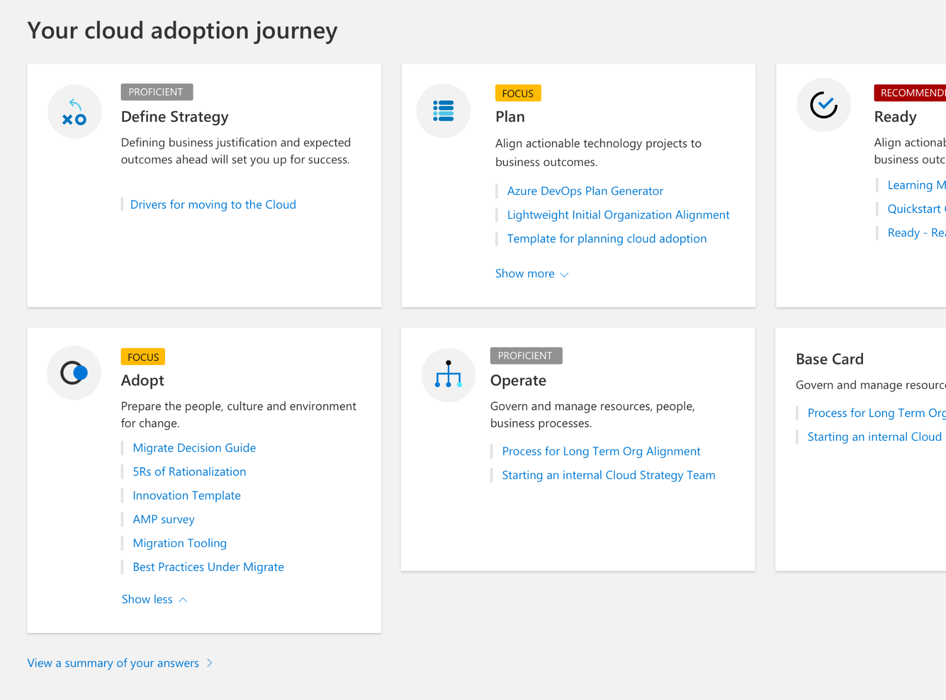
Demo Before we begin…..
Let’s take a few minutes to capture current state of your cloud adoption using the “Cloud Journey Tracker”

Slide 12
Define your strategy
Notes:
Ref: https://docs.microsoft.com/en-us/azure/cloud-adoption-framework/overview

Slide 13
Define Strategy
Document your cloud strategy to help stakeholders understand the business outcomes the organization is pursuing by adopting the cloud.
1
Motivations
Understand motivations to move to the cloud.
2
Business Outcomes
Engage stakeholders to document specific business outcomes.
3
Business Justification
Develop a business justification that supports your motivations and outcomes.
4
Identify First Project
Leverage business and technical criteria to choose your first project.

Slide 14
Cloud Strategy | Cloud Adoption Motivations Engage stakeholders across business and technology to understand your motivations for cloud adoption
Migration Motivations
Cost Savings
Reduction in vendor or technical complexity
Optimization of internal operations
Increase business agility
Prepare for new technical capabilities
Scale to meet market demands
Scale to meet geographic demands
Critical Business Events
Data center exit
Mergers, acquisition or divestiture
Reductions in capital expenses
End of support for mission critical technologies
Regulatory compliance, data sovereignty requirements
Reduce disruptions and improve IT stability
Innovation Motivations
Prepare for new technical capabilities
Build new technical capabilities
Scale to meet market demands
Scale to meet geographic demands
Improve customer experiences / engagements
Transform products or services
Disrupt the market with new products or services
Notes:
<Key point>: There is no single, typical cloud adoption motivation in cloud adoption—typically there are more than one.
Cloud adoption is an iterative process. There can be many motivations for why your organization is planning digital transformation.
It’s important to engage cross-functional business groups across the enterprise to explore cloud adoption motivations.
[Go through list of Critical Business Events.
[Read through Migration Motivations and Innovation Motivations]

Slide 15


Define Strategy | Identify Business Outcomes Engage different stakeholders and document desired outcomes across these categories
Fiscal outcomes include increased revenue, savings in cost and drive profits
Agility outcomes include time-to-market and provision time to respond to changes
Reach outcomes include global access and data sovereignty
Customer engagement outcomes include meeting customer expectations by reducing cycle times
Performance outcomes include having highly available, global applications
Security & Compliance regulations addressed and implemented
Use the business document template to identify your business outcomes

Slide 16


Define Strategy | Develop Business Justification
Dispel common cloud migration myths such as…
An operating expense model is better than a capital expense model
I have less visibility and control over my cloud resources
Everything should go into the cloud
Mirroring on-premise environment will save money in the cloud
Cloud is always cheaper
Moving to the cloud is like flipping a switch
Public Cloud is not secure
I can run workloads on-prem cheaper than in the cloud
Server costs drive business cases for cloud migration

Slide 17
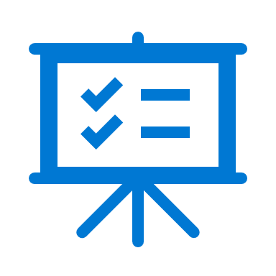
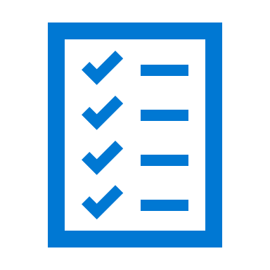

Define Strategy | Identify First Project
Choose the first project to move to the cloud by using a clearly defined criteria and clearly identified outcomes to achieve.
First Project Criteria
First Project Expectations
First Project Examples for each motivation category
Should align with your motivations for cloud adoption
Should demonstrate progress towards a defined business outcome
Project is a source of learning.
It might result in production deployments, but it will probably require additional effort first.
The output of this project is a set of clear requirements to provide a longer-term production solution.
Critical business events: Use Azure Site Recovery as a disaster recovery tool, reducing dependencies on disaster recovery assets within the datacenter.
Migration motivations: Start with a noncritical workload and use Azure setup guide and the Azure migration guide for guidance
Innovation motivations: Creation of a targeted dev/test environment can be a great first project.

Slide 18
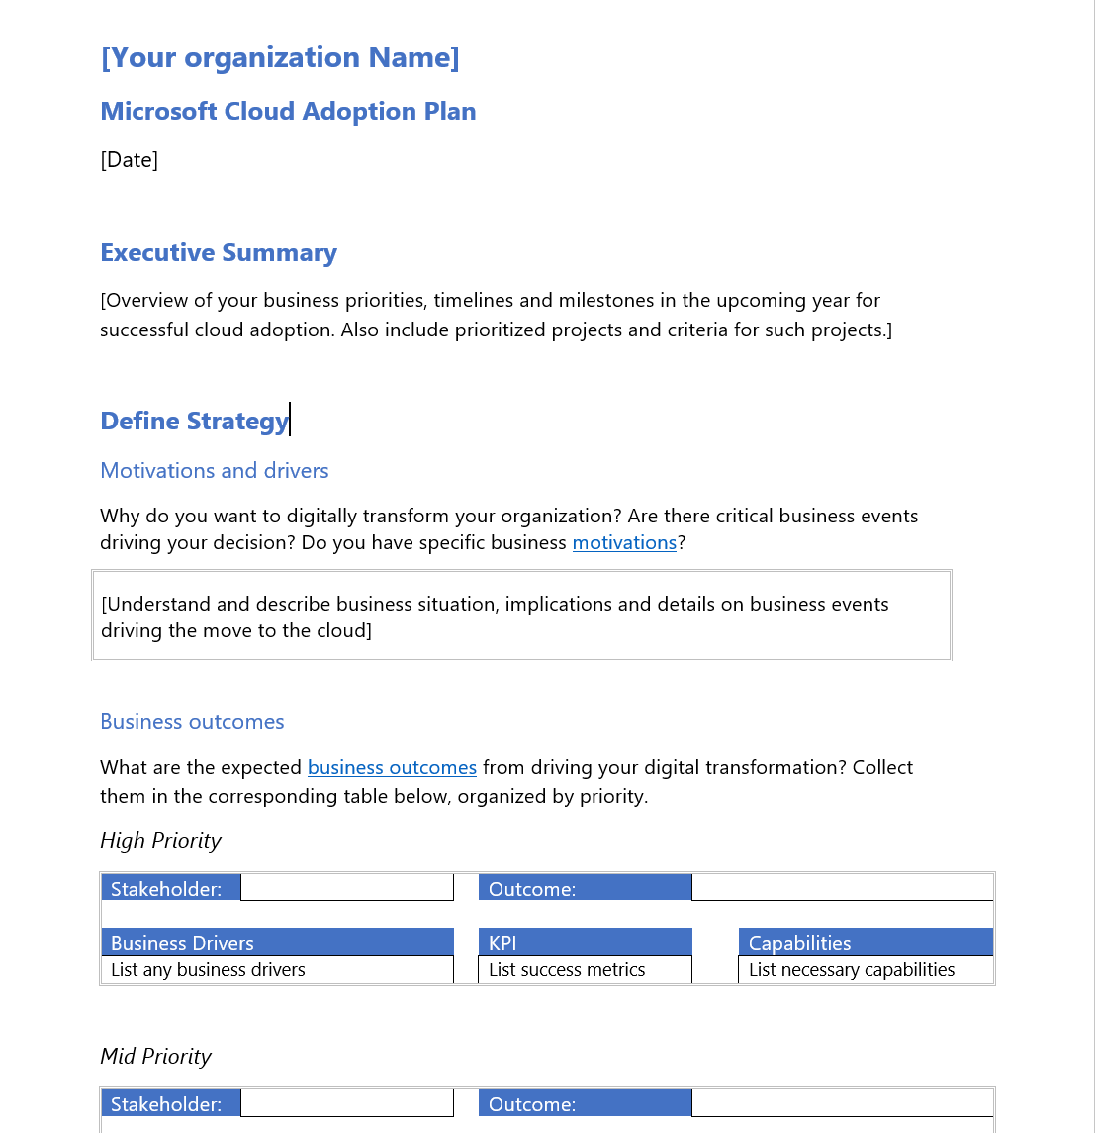
Define Strategy | Cloud Strategy and Plan Template
Cloud adoption plan converts the aspirational goals of the cloud adoption strategy into an actionable plan
All the cloud teams leverage the cloud adoption plan to guide technical efforts, in alignment with the business outcomes.
Download the template and get started with creating your plan

Slide 19
Putting together your plan
Notes:
Ref: https://docs.microsoft.com/en-us/azure/cloud-adoption-framework/overview

Slide 20
Plan
Cloud adoption plans convert the aspirational goals of the cloud adoption strategy into actions. It will help guide technical efforts, in alignment with the business strategy.
1
Rationalize Digital estate
Rationalize your digital estate to determine best approach to cloud adoption.
2
Initial org alignment
Align governance and cloud adoption to mitigate risks.
3
Skills readiness plan
Get your people ready by identifying skills gap and plan.
4
Cloud adoption plan
Create an actionable cloud adoption plan that aligns to your business strategy.

Slide 21
Plan | Rationalize Digital Estate
Cloud rationalization is the process of evaluating assets to determine the best approach to hosting them in the cloud (public or hybrid)
Rationalization can take place using an incremental approach or ‘Power of 10’ where the cloud strategy team selects the first 10 applications to be migrated which are a mix of simple and complex workloads; (recommended approach)
The output of a rationalization effort is a prioritized backlog of all assets that are affected by the chosen transformation.
Use costing models from your chosen cloud provider to forecast costs for your prioritized backlog; for Azure, we have pricing tools like Azure Migrate, Azure pricing calculator and Azure cost management. Ensure that hybrid is incorporated into the costing models.

Slide 22

Plan | Initial Org Alignment
Implementing Cloud adoption plan requires some initial alignment of different stakeholders who will make the plan a reality.
Cloud Adoption Team
Cloud Governance Team
Speed vs. Control
Create a balance between speed or moving quickly and control or reducing risks by have teams accountable for adoption and governance.
While cloud adoption team is required to execute cloud adoption tasks, governance team ensures processes and controls are implemented.

Slide 23
Plan | Skills Readiness Plan
Cloud computing is a technology shift, and a new set of skills are required to support cloud solutions.
Commoditized skills
Solution Manager
UI Designer UX Designer
Tester SDET
Developer
Application Operation & Support
Network Datacenter Engineer
Statistician Analyst
DBA Data Analyst
Relationship Manager
Trusted Advisor
Business Architect
Best use of assets
Process Engineer
Real-enough time
Engineering & DevOps
It works, build for monitoring self-healing
Edge/Wireless Networking
Secure, anywhere access
Cloud Architect
Secure, Anywhere access
Data Scientist
Business Insight
Information Architect
Trustworthy data
Strategic skills for the new era
1. Identify the gaps
2. Look across teams
3. Create an org-wide learning plan
Notes:
https://docs.microsoft.com/en-us/azure/cloud-adoption-framework/plan/suggested-skills

Slide 24
Plan | Cloud Adoption Plan
Translate strategy and effort into an actionable cloud adoption plan.
Prerequisites: Confirm that all prerequisite steps have been completed before you create your plan.
Define and prioritize workloads: Prioritize your first 10 workloads to establish an initial adoption backlog.
Align assets: Identify which assets (proposed or existing) are required to support the prioritized workloads.
Review rationalization: Review rationalization decisions to refine adoption-path decisions: Migrate or Innovate.
Define iterations and releases: Iterations are the time blocks allocated to do work. Releases are the definition of the work to be done before triggering a change to production processes.
Estimate timelines: Establish rough timelines for release planning purposes, based on initial estimates.

Slide 25
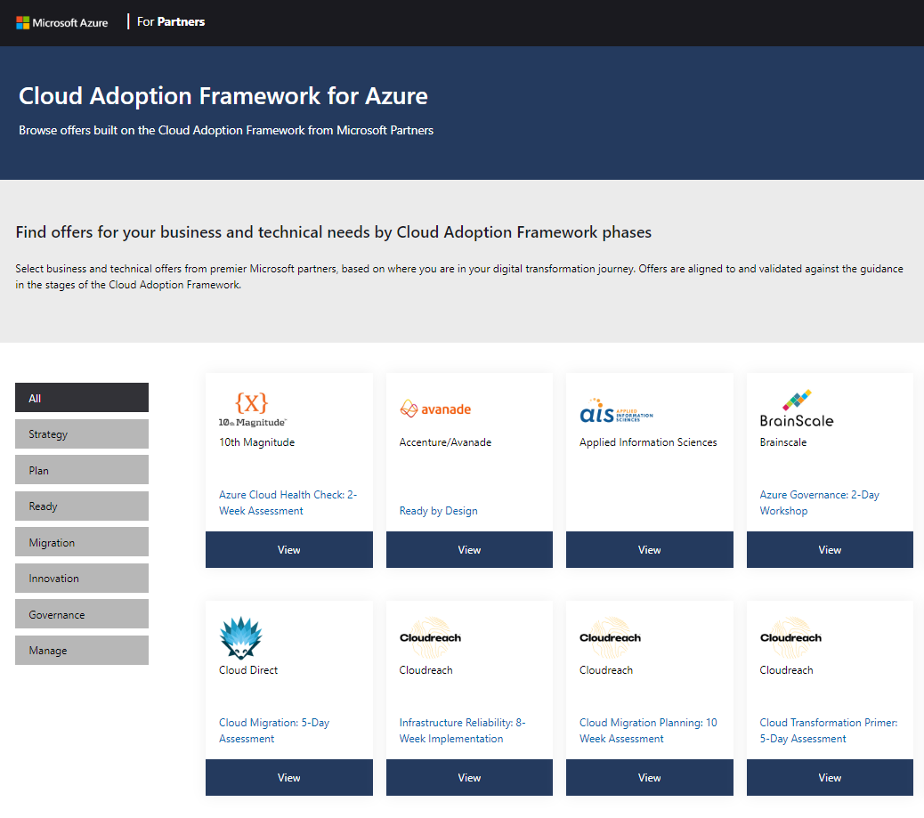
Find a Microsoft Partner
Connect with trusted Microsoft partners for expert business and technical solutions
aka.ms/adopt/partneroffers
Notes:
<Key point> Connect with trusted Microsoft Partners for expert business and technical solutions
<Transition>

Slide 26
Accelerate your digital transformation journey
Find a partner
https://aka.ms/adopt/ partneroffers
Take an assessment
https://aka.ms/adopt/ assess
Read documentation
https://aka.ms/adopt/ overview
Find consulting services
Microsoft Consulting Services
Complete learning module
Microsoft Learn
Notes:
<Key point> There are a variety of next steps you can take to accelerate your digital transformation.

Slide 27
Thank you
Notes:
Thank You

